Slide 1
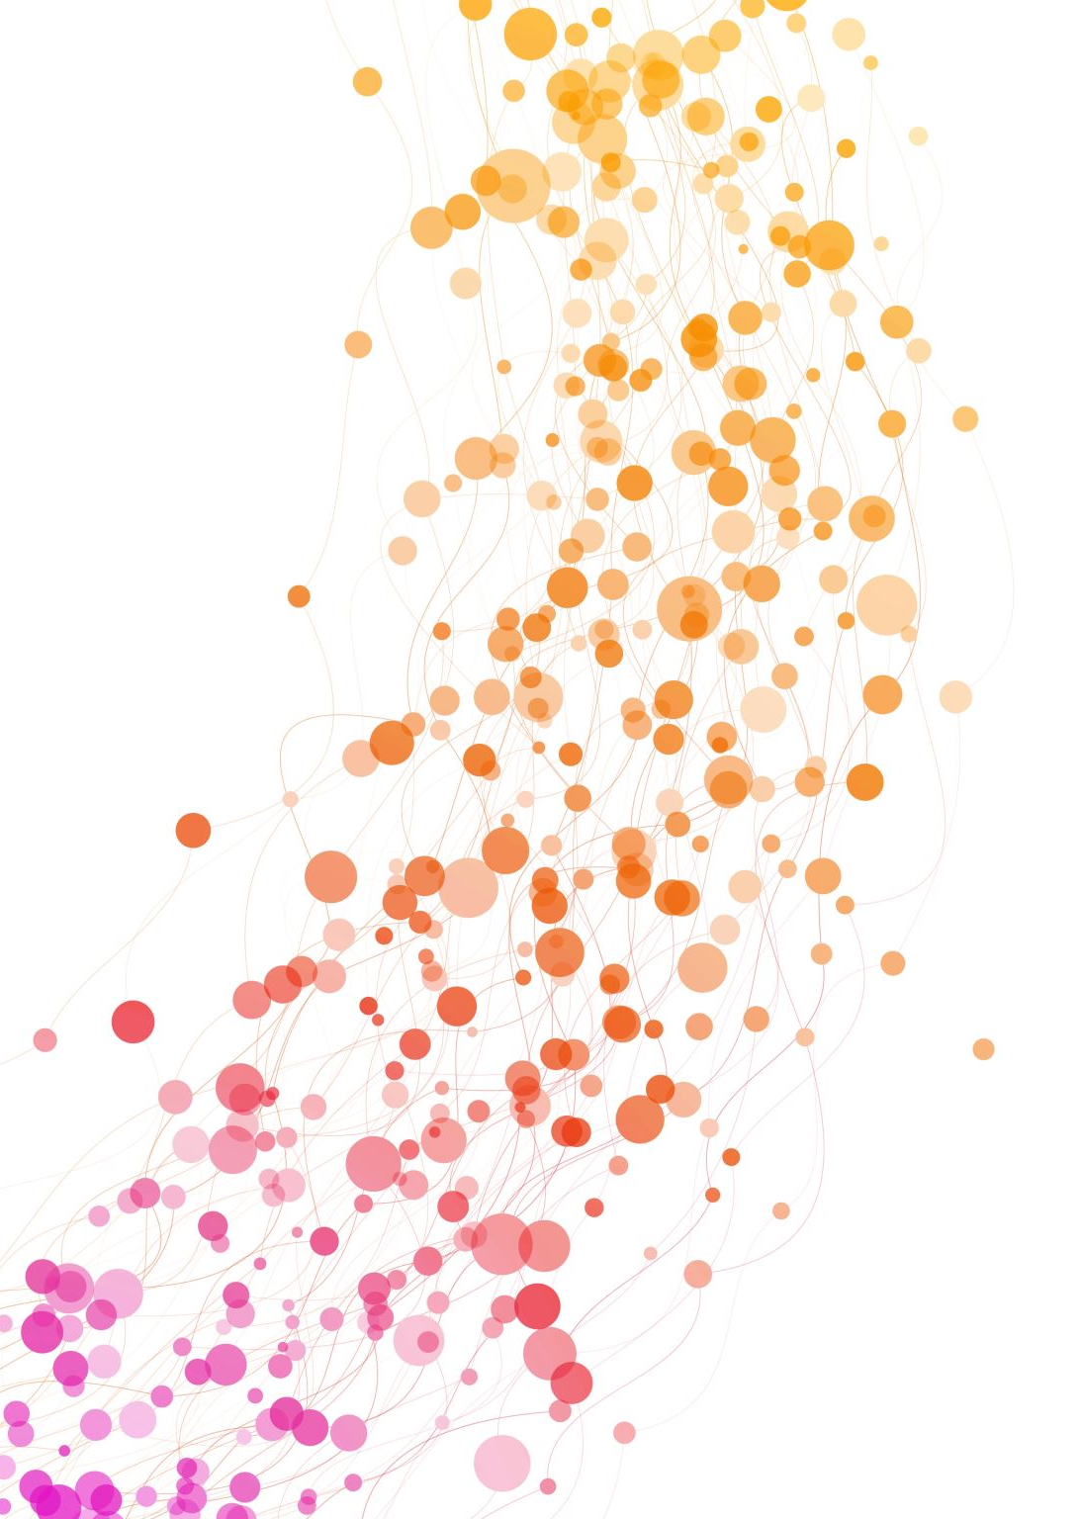
Deep Learning for COVID-19 Detection Using Chest X-Ray Images EfficientNetB1 Reproduction & Enhancement Using Focal Loss Health & Wellness — AI & Deep Learning Project
Presented by: [Group Names] Date: November 25, 2025

Slide 2
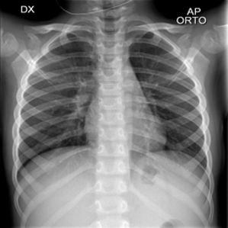
Motivation
COVID-19 created the need for fast, accessible, reliable diagnostic tools.
RT-PCR is accurate but slow and resource-intensive.
Chest X-Ray is widely available and low-cost → ideal for quick triage.
Deep Learning can identify subtle radiological patterns.
Supports Health & Wellness by improving early detection.

Slide 3
Problem Statement
We aim to classify chest X-rays into four classes:
COVID-19
Lung Opacity (Pneumonia)
Normal
Viral Pneumonia
Two goals:
Reproduce a 2022 deep learning paper (EfficientNetB1).
Improve the model using Focal Loss + Strong Augmentation to boost minority-class performance.

Slide 4
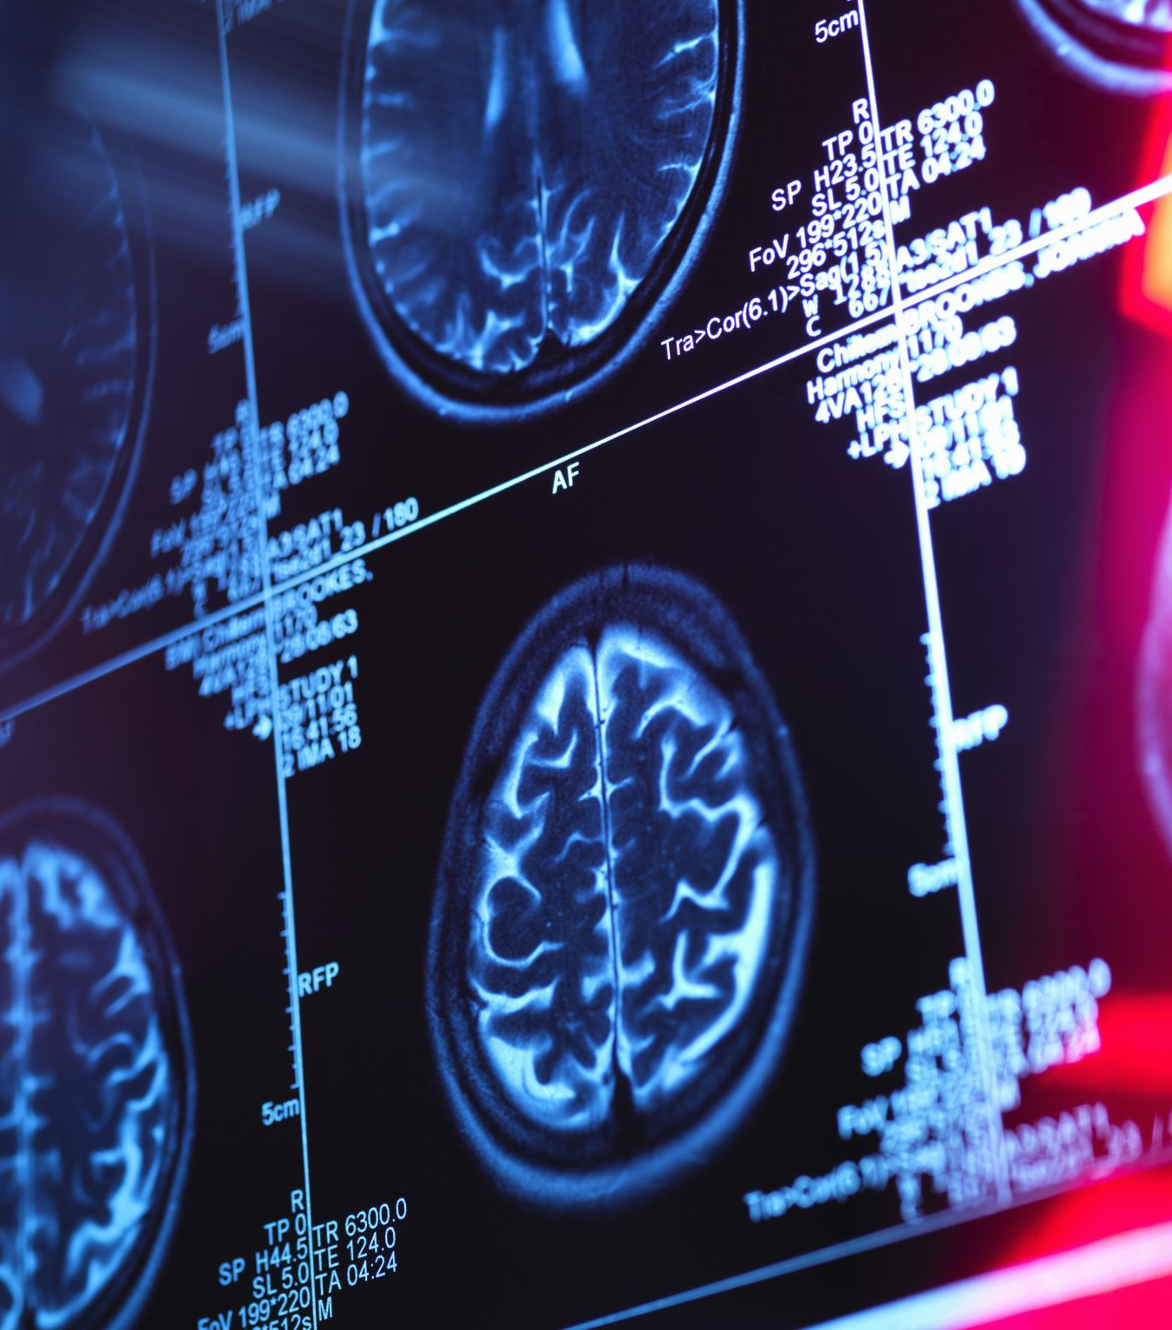
Dataset
COVID-19 Radiography Database (Kaggle)
Total images: ~21,000+
Four classes: COVID-19, Lung Opacity, Normal, Viral Pneumonia
Preprocessing:
Resize to 240×240
Normalization
Train/Val/Test = 70% / 20% / 10%
Images originate from multiple global hospitals.

Slide 5
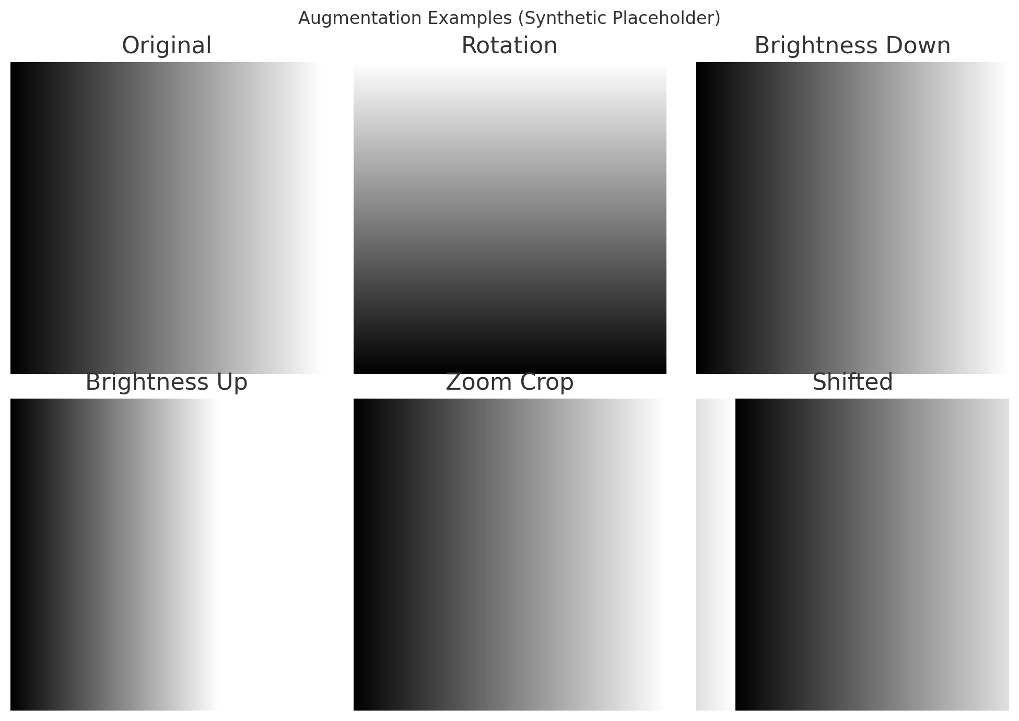
Augmentation Grid

Slide 6
Paper Summary
Paper: “Chest X-Ray Classification for the Detection of COVID-19 Using Deep Learning Techniques” (Sensors, 2022)
Compared EfficientNetB1, NasNetMobile, MobileNetV2
Two strategies:
Strategy I – Basic classifier head
Strategy II – BN + L2 + Dropout
EfficientNetB1 (Strategy II) achieved ~96% accuracy
Key Features:
Use of strong regularization
Transfer learning on medical images

Slide 7

Critical Review of the Paper
✔ Strengths:
Clear experiment structure
Strong evaluation metrics
Well-designed regularization strategy
Good benchmark comparison
✖ Limitations:
No external validation
Class imbalance minimally addressed
No interpretability (Grad-CAM)
No inference or deployment analysis

Slide 8
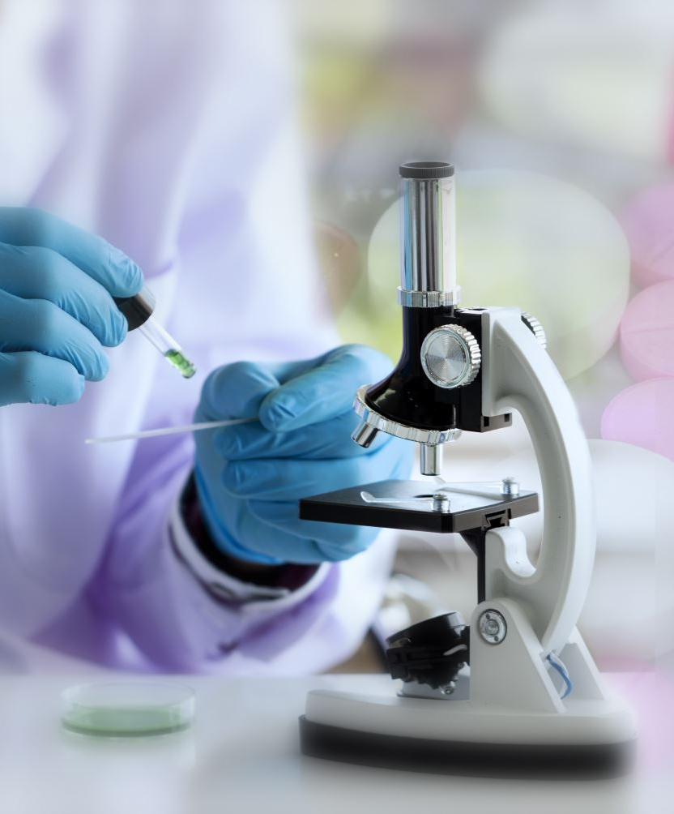
Our Research Question
RQ: Does class-balanced focal loss + strong augmentation improve minority-class (COVID-19) detection compared to cross-entropy?
Motivation:
COVID-19 images are the minority
Cross-entropy treats all classes equally
Focal loss emphasizes hard / rare samples
Strong augmentation improves model robustness

Slide 9

Baseline Model
EfficientNetB1 + Strategy II (Reproduction)
Pretrained on ImageNet
Global Average Pooling
BN → Dense(256, ReLU, L2) → Dropout(0.5)
Dense(4, Softmax)
Loss: Categorical Cross-Entropy
Optimizer: Adam (LR=1e-4)
Regularization: Dropout, Weight Decay, LR Scheduling

Slide 10
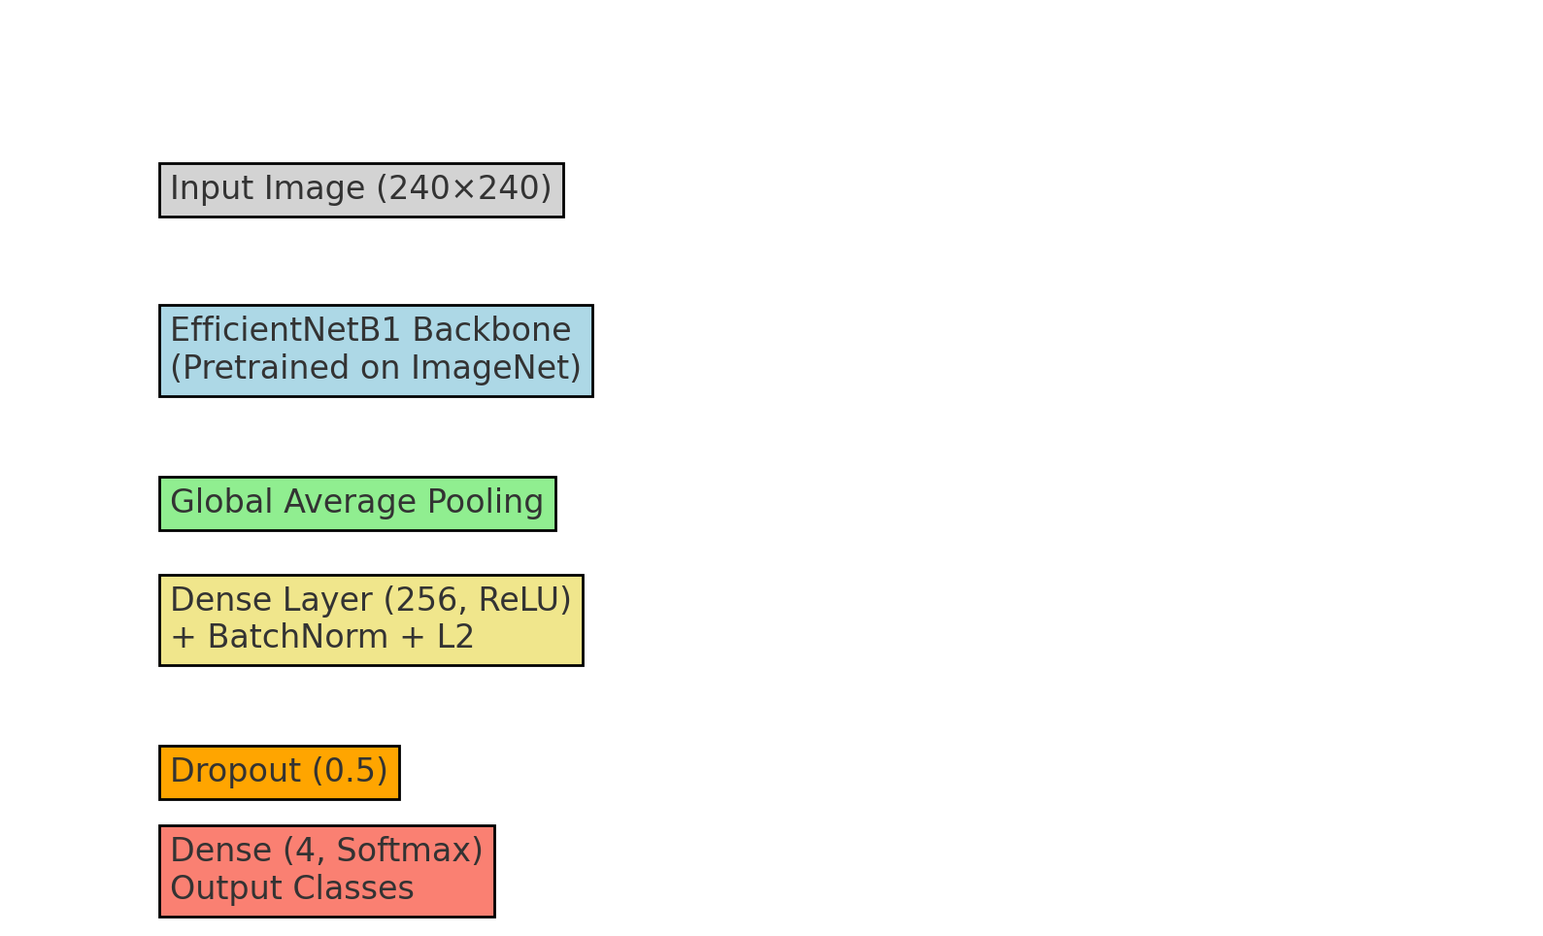
Model Architecture Diagram

Slide 11
Proposed Improvements
1. Focal Loss
γ = 2, α = inverse class frequency
Focuses training on hard-to-classify samples
Reduces majority-class dominance
2. Strong Data Augmentation
Rotation
Brightness changes
Zoom
Translation
Horizontal/Vertical flip
Goal: Improve generalization + reduce overfitting

Slide 12
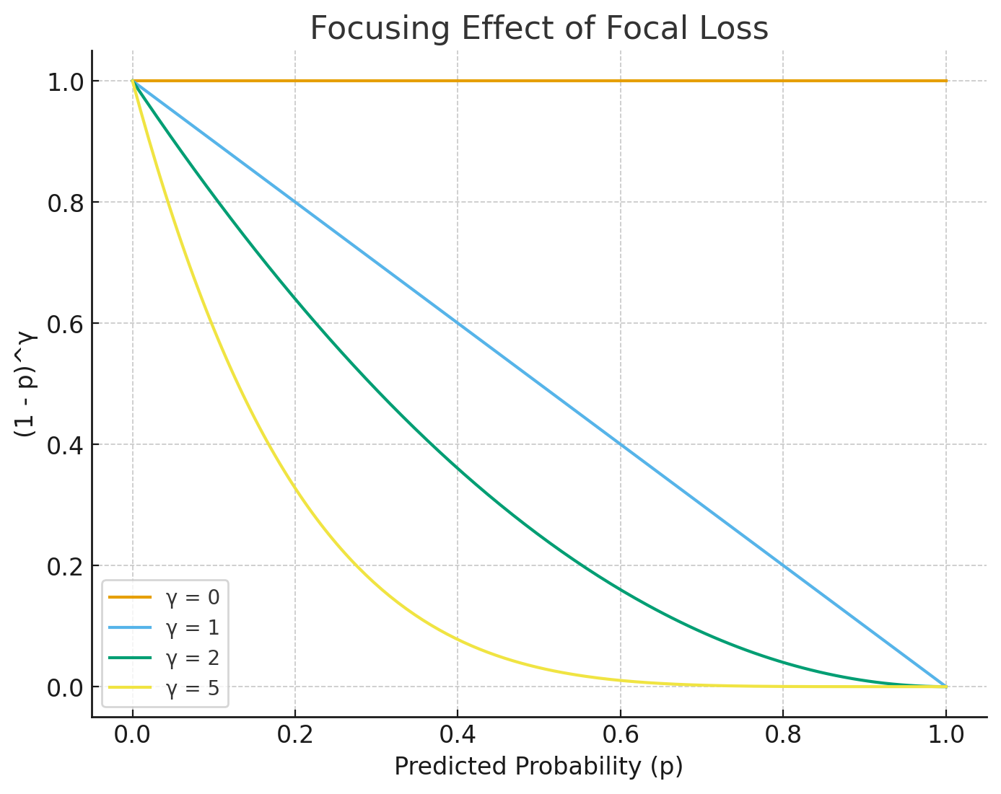
Focal Loss Concept Graph

Slide 13
Results Overview
Accuracy & Macro F1
COVID-19 Recall
Baseline: 0.938
Focal: 0.949
Focal + Aug: 0.958
Strong improvement in minority-class performance.
Model | Accuracy | Macro F1
Baseline | 0.953 | 0.945
Focal Loss | 0.958 | 0.952
Focal + Aug | 0.961 | 0.956

Slide 14
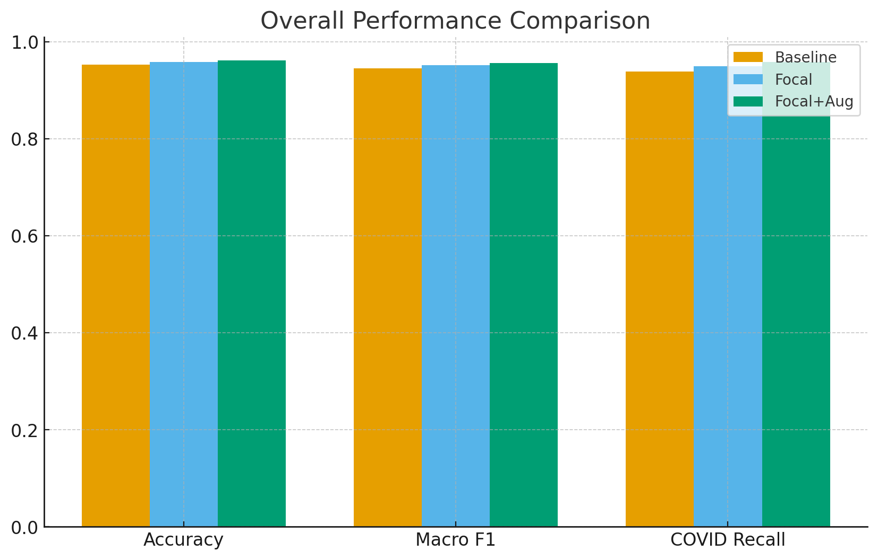
Overall Performance Comparison Chart

Slide 15

Confusion Matrices (Summaries)
Baseline
COVID-19 correctly predicted: 852/885
Some misclassifications with Lung Opacity
Focal Loss
Higher sensitivity to COVID-19
Reduced false negatives
Focal + Strong Augmentation
Best overall balance
Most robust generalization
(Full matrices included in the report.)

Slide 16
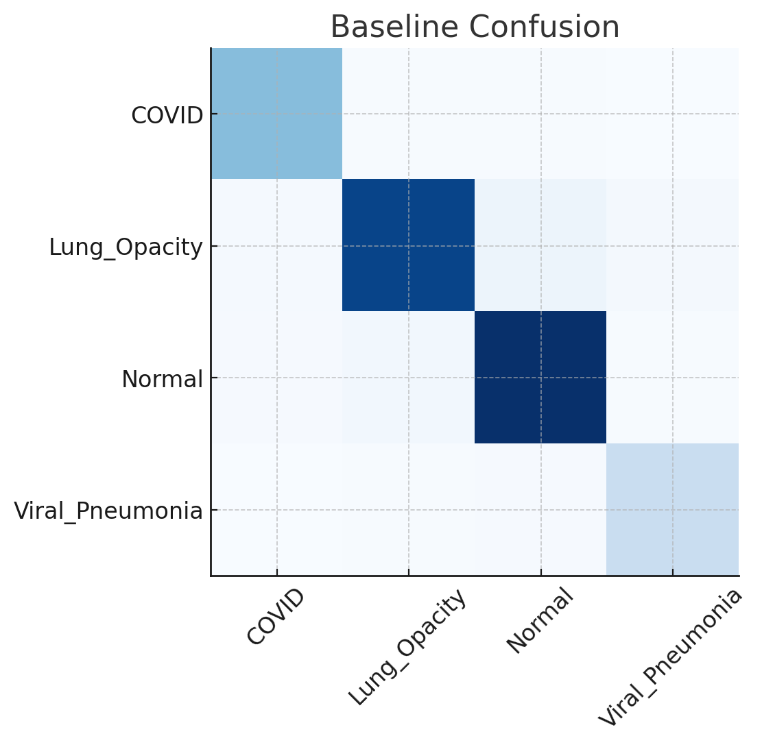
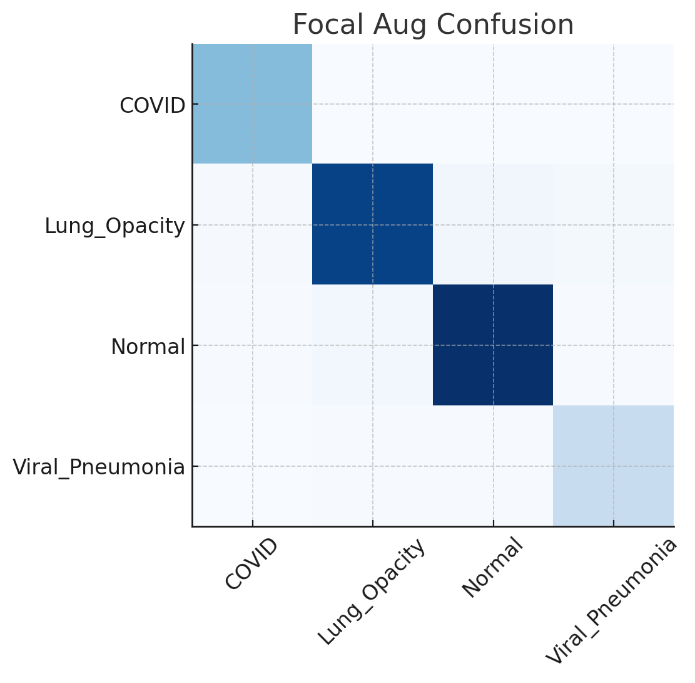
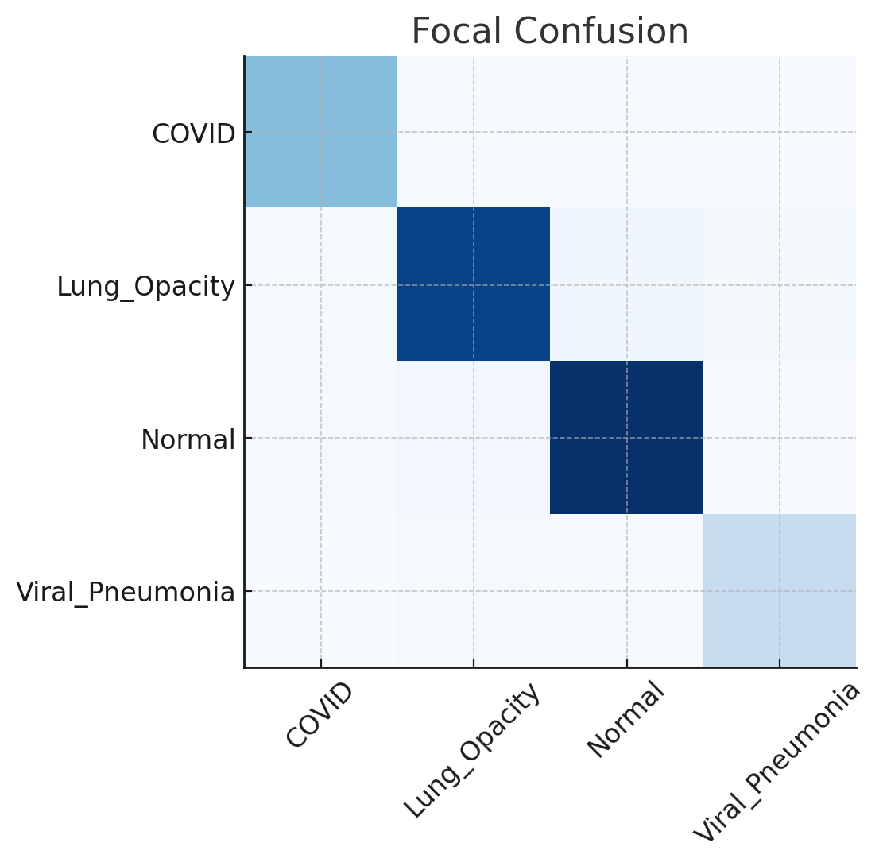
confusion matrix heatmap

Slide 17
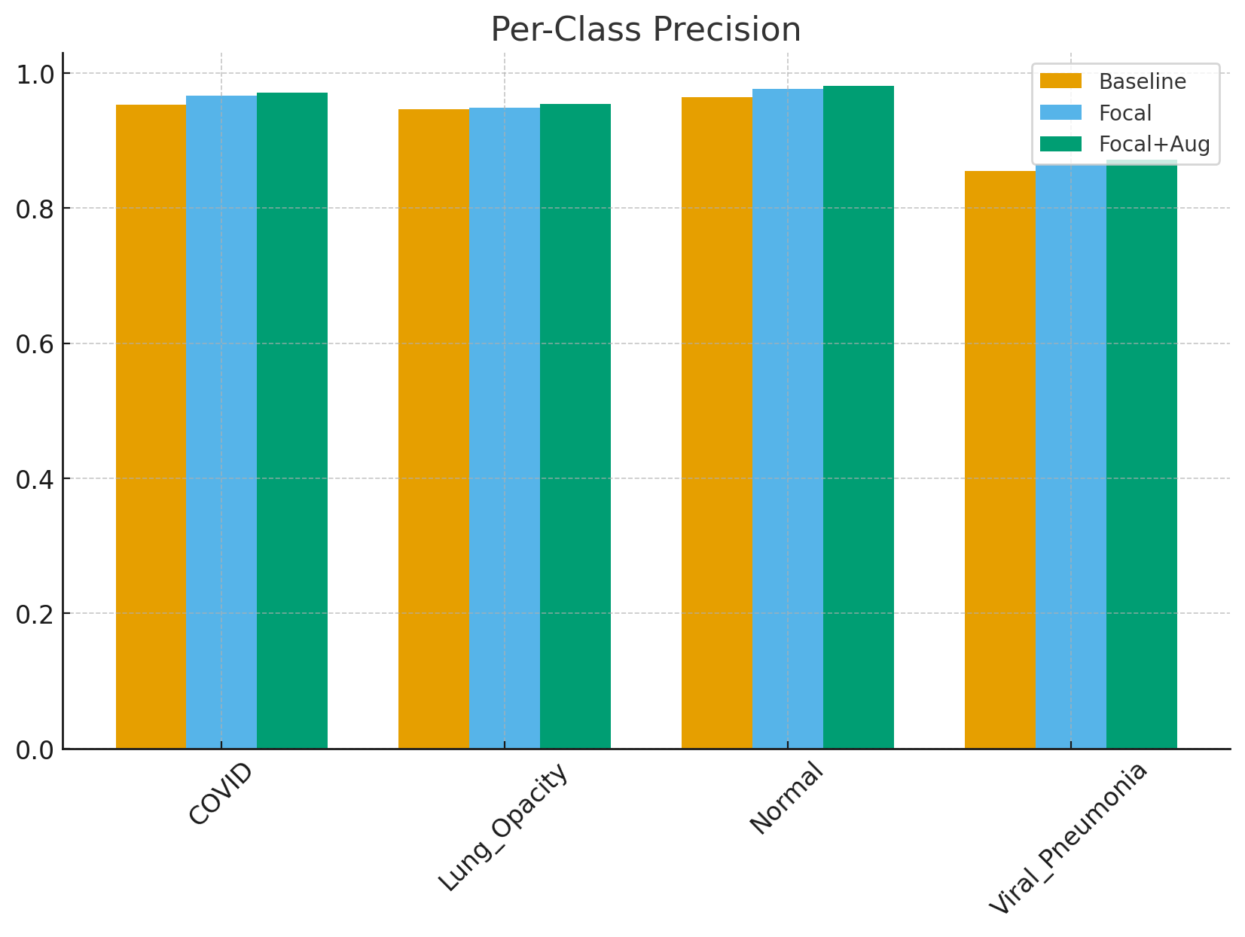
Per-Class Precision Chart

Slide 18
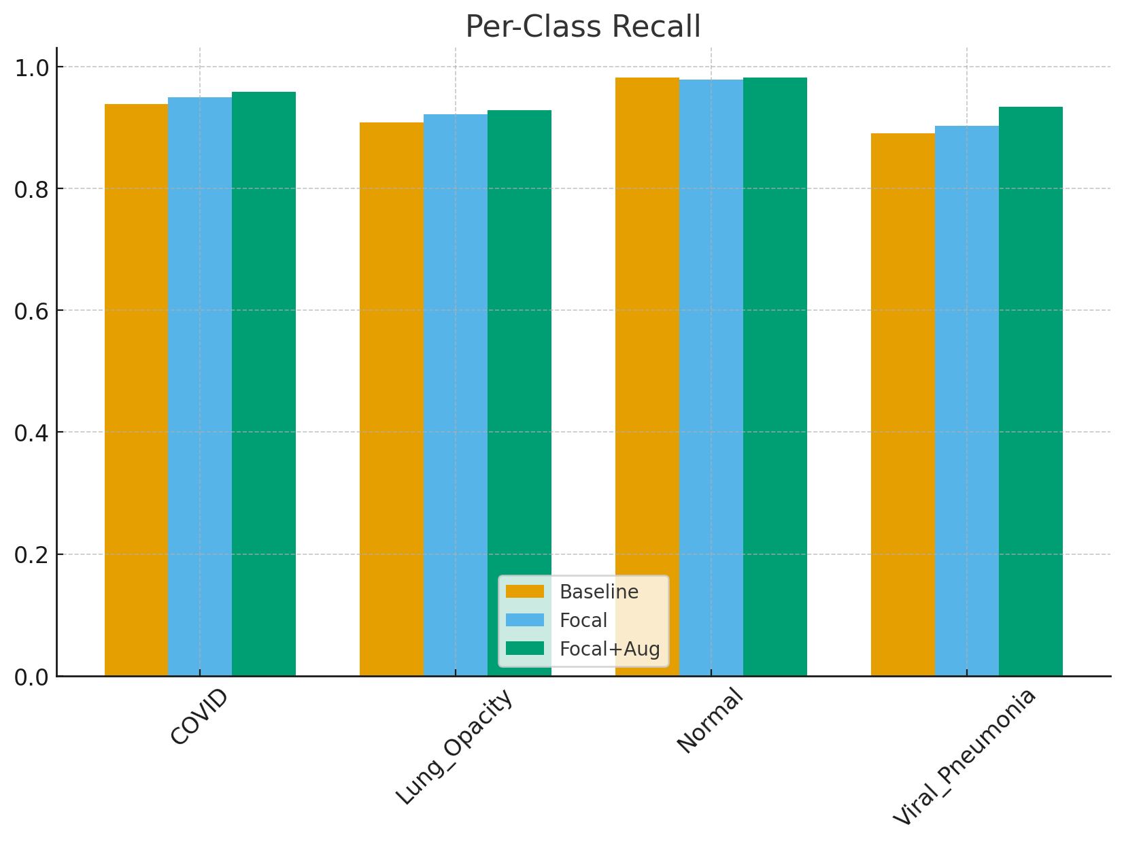
Per-Class Recall Chart

Slide 19
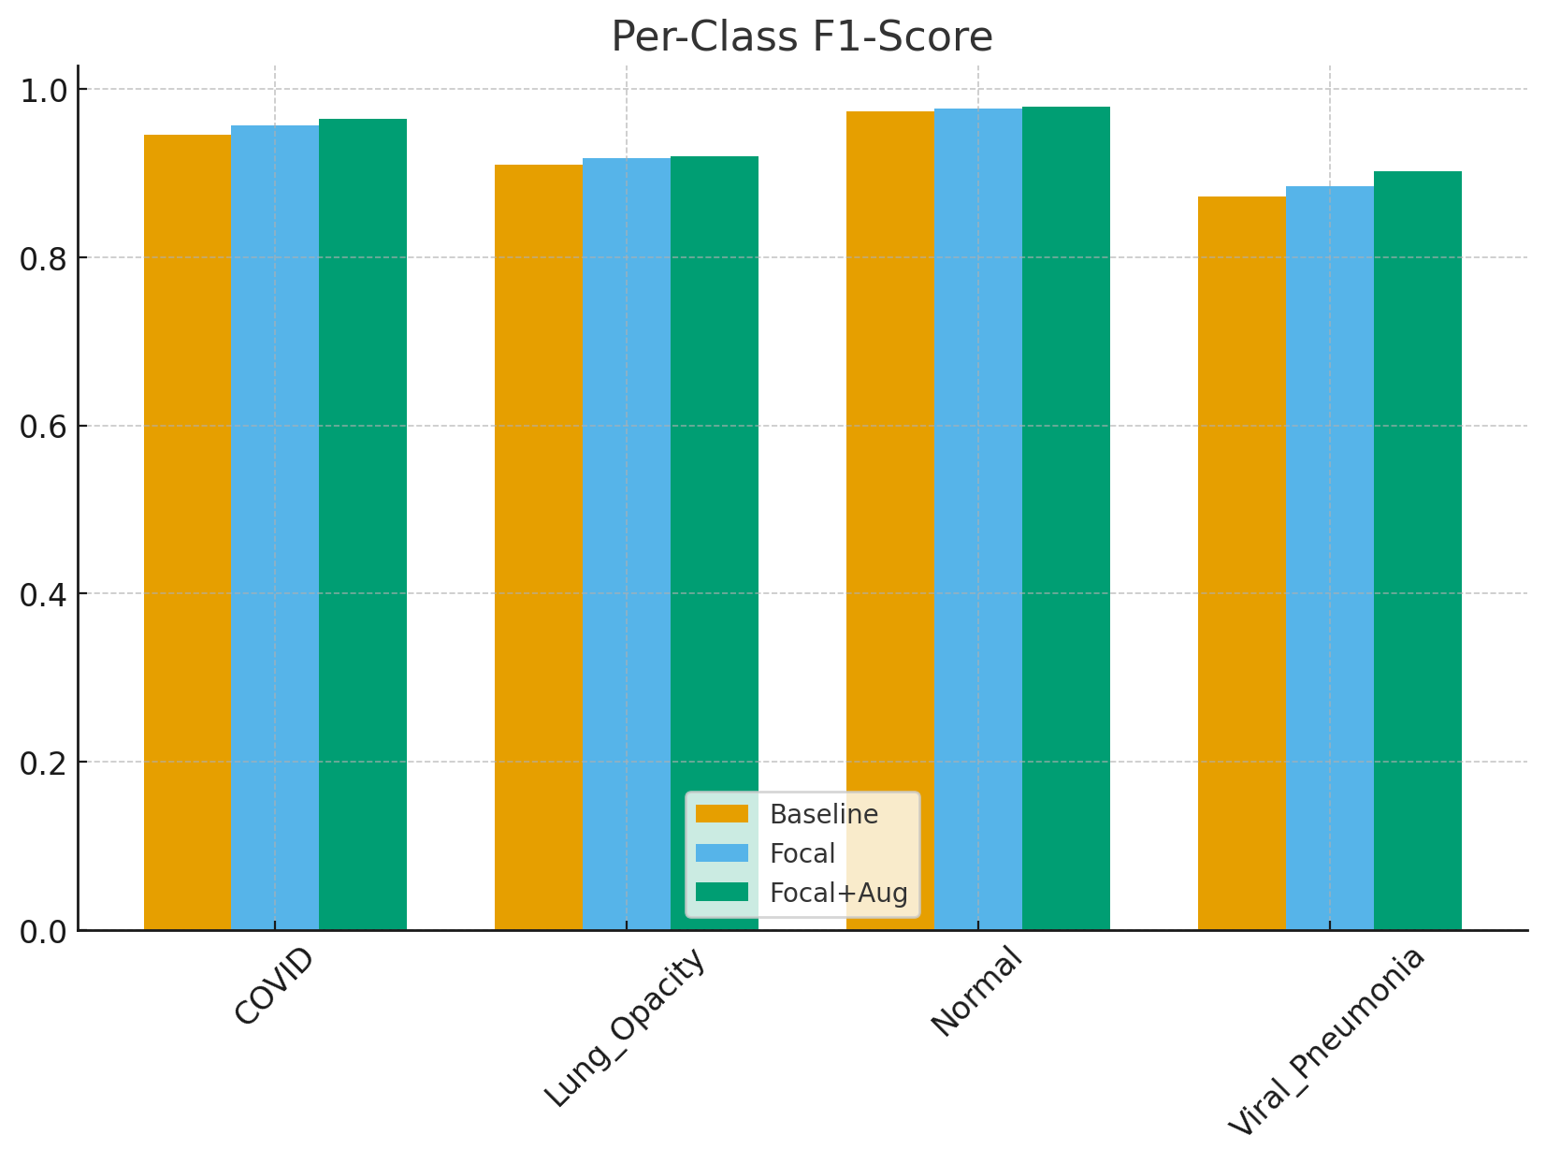
Per-Class F1 Chart

Slide 20
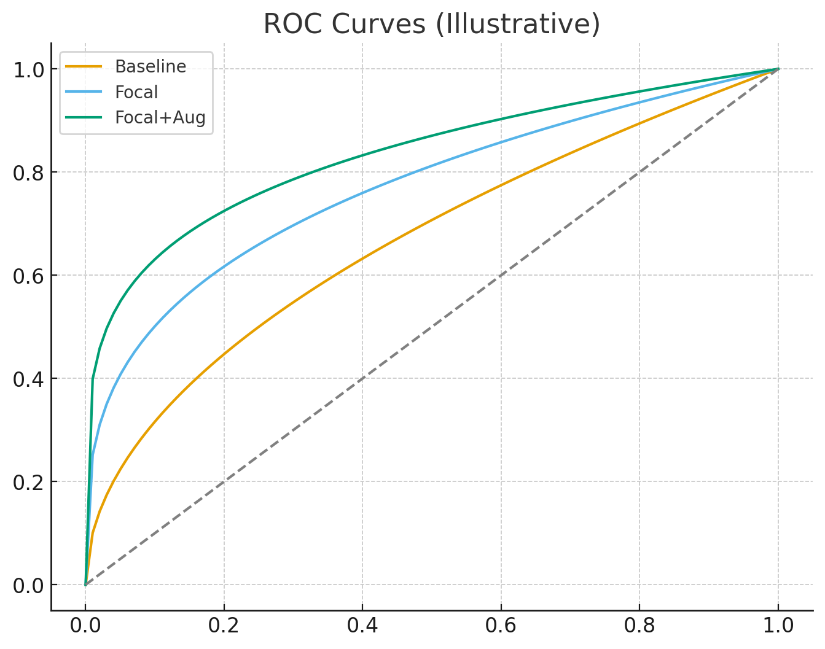
ROC Curve Template

Slide 21

Discussion
Baseline EfficientNetB1 performs well, matching paper results.
Focal Loss reduces false negatives, critical in healthcare.
Strong augmentation provides extra robustness against variations.
Improvements align with research question and medical needs.

Slide 22

Conclusion
Successfully reproduced a state-of-the-art COVID-19 detector.
Proposed enhancements improved:
COVID-19 recall
Macro-F1
Overall robustness
Demonstrates that advanced loss functions and augmentation significantly enhance medical DL models.

Slide 23
Future Work
External validation on multi-hospital datasets
Interpretability tools (Grad-CAM, saliency maps)
Deploy lightweight versions for clinics or mobile devices
Multi-label classification (co-existing diseases)
Integration with real healthcare systems (triage AI)

Slide 24

Thank you

